Slide 1
Customer Centric app

Slide 2
CHALLENGES
Flexible pricing model requires manual evaluation (TTS)
Multiple tightly integrated processes make it difficult to make the system lean
Payment’s processing is the major slowdown

Slide 3
The solution is web-based platform to book and manage port services
Observability - structured reports and insights in to the service
Provision speed - services can be provided a lot faster
Services at scale - easier to integrate more, open to external services and collecting platform fee, wider supply chain
Business process review and optimization
Service catalogue
future vision

Slide 4
BUSINESS MODEL
Lists service in port
Lists port & services
Service provider
Platform
Port Authority
Fulfil service
Requests service
Receiving service
Vessel
transaction based business model, commission fee of 10% paid by

Slide 5
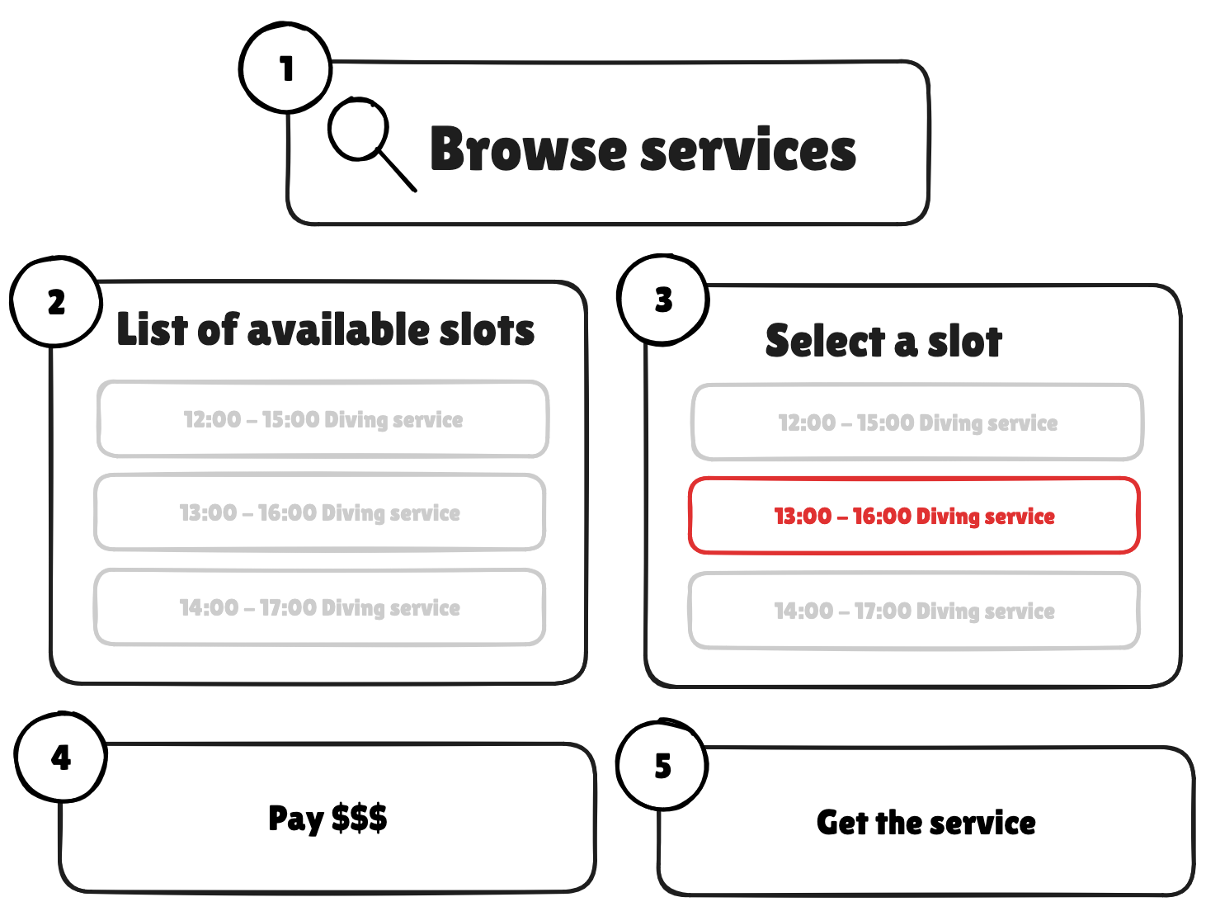

Slide 6



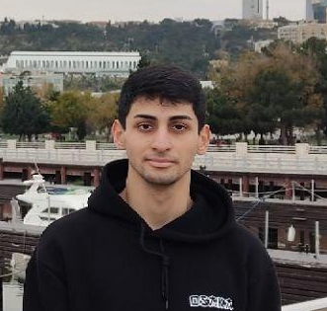
Why us? All required expertise combined.
Dennis Ruske
Hamburg, Germany
Venture Building & VC @ HHLA Next
Former Entrepreneur, Product Lead, Software Engineer
Orkhan Mirzayev
Klaipeda, Lithuania
MSc Shipping and Port engineering in Klaipeda University,
BSc Marine Navigation engineering, Sailor
Bernardas Juzumas
Trušeliai, Lithuania
IT Engineering, Architecture, process automation and optimization, development, data science
,
Kostas Ereksonas
Klaipėda, Lithuania
MSc Information Systems Engineering Student at Klaipėda University

